Slide 1
ATAI
Advanced Technique of Artificial Intelligence
ATAI
ChongqingUniversity _{AdvancedTechniqueof}
of Technology Artificial Intelligence
Chongqing University of
Technology
Chongqing University ^{ATAI}
_{of Technology} Advanced Techniqueof
Artificial Intelligence
Chongqing University of Technology
Chongqing University of Technology
Disentangling and Generating Modalities for Recommendation in
Missing Modality Scenarios
Code : https://github.com/ptkjw1997/DGMRec
—— SIGIR2025
Reported by Jing Li
1

Slide 2
ATAI
Advanced Technique of Artificial Intelligence
ATAI
ChongqingUniversity _{AdvancedTechniqueof}
of Technology Artificial Intelligence
Chongqing University of
Technology
Chongqing University ^{ATAI}
_{of Technology} Advanced Techniqueof
Artificial Intelligence
Chongqing University of Technology
Chongqing University of Technology
Motivation
1、Items often suffer from partial or complete modality absence. Current solutions either remove such items or use simplistic imputation methods like global means or the nearest neighbor mean. Although injection methods are shown to be effective ,they still encounter a significant performance drop under missingmodality scenarios.
2、Each modality contains unique, modality-specific information that cannot be fully captured by other modalities. For this reason, forcing alignment between modalities can obscure their unique contributions and adversely affect recommendation performance.

Slide 3
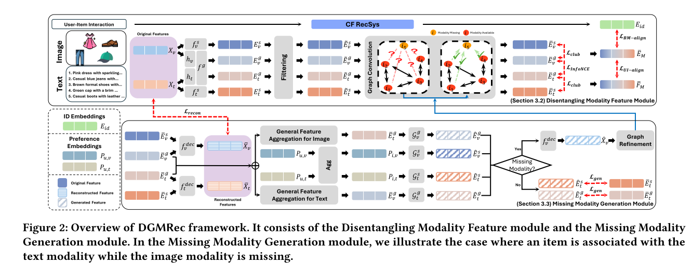
ATAI
Advanced Technique of Artificial Intelligence
ATAI
ChongqingUniversity _{AdvancedTechniqueof}
of Technology Artificial Intelligence
Chongqing University of
Technology
Chongqing University ^{ATAI}
_{of Technology} Advanced Techniqueof
Artificial Intelligence
Overview
Chongqing University of Technology
Chongqing University of Technology

Slide 4
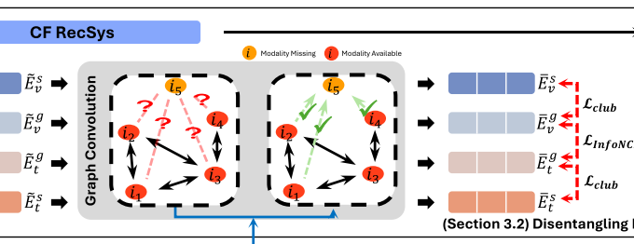
ATAI
Advanced Technique of Artificial Intelligence
ATAI
ChongqingUniversity _{AdvancedTechniqueof}
of Technology Artificial Intelligence
Chongqing University of
Technology
Chongqing University ^{ATAI}
_{of Technology} Advanced Techniqueof
Artificial Intelligence
Chongqing University of Technology
Chongqing University of Technology
Method

Slide 5
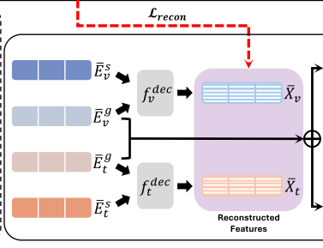
ATAI
Advanced Technique of Artificial Intelligence
ATAI
ChongqingUniversity _{AdvancedTechniqueof}
of Technology Artificial Intelligence
Chongqing University of
Technology
Chongqing University ^{ATAI}
_{of Technology} Advanced Techniqueof
Artificial Intelligence
Chongqing University of Technology
Chongqing University of Technology
Method

Slide 6
ATAI
Advanced Technique of Artificial Intelligence
ATAI
ChongqingUniversity _{AdvancedTechniqueof}
of Technology Artificial Intelligence
Chongqing University of
Technology
Chongqing University ^{ATAI}
_{of Technology} Advanced Techniqueof
Artificial Intelligence
Chongqing University of Technology
Chongqing University of Technology
Method

Slide 7
ATAI
Advanced Technique of Artificial Intelligence
ATAI
ChongqingUniversity _{AdvancedTechniqueof}
of Technology Artificial Intelligence
Chongqing University of
Technology
Chongqing University ^{ATAI}
_{of Technology} Advanced Techniqueof
Artificial Intelligence
Chongqing University of Technology
Chongqing University of Technology
Method

Slide 8
ATAI
Advanced Technique of Artificial Intelligence
ATAI
ChongqingUniversity _{AdvancedTechniqueof}
of Technology Artificial Intelligence
Chongqing University of
Technology
Chongqing University ^{ATAI}
_{of Technology} Advanced Techniqueof
Artificial Intelligence
Chongqing University of Technology
Chongqing University of Technology
Method

Slide 9
ATAI
Advanced Technique of Artificial Intelligence
ATAI
ChongqingUniversity _{AdvancedTechniqueof}
of Technology Artificial Intelligence
Chongqing University of
Technology
Chongqing University ^{ATAI}
_{of Technology} Advanced Techniqueof
Artificial Intelligence
Chongqing University of Technology
Chongqing University of Technology
Experiments

Slide 10
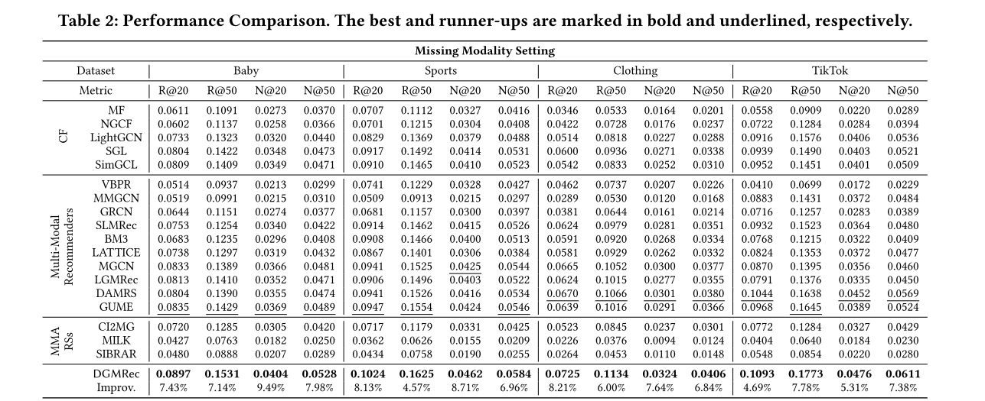
ATAI
Advanced Technique of Artificial Intelligence
ATAI
ChongqingUniversity _{AdvancedTechniqueof}
of Technology Artificial Intelligence
Chongqing University of
Technology
Chongqing University ^{ATAI}
_{of Technology} Advanced Techniqueof
Artificial Intelligence
Chongqing University of Technology
Chongqing University of Technology
Experiments

Slide 11
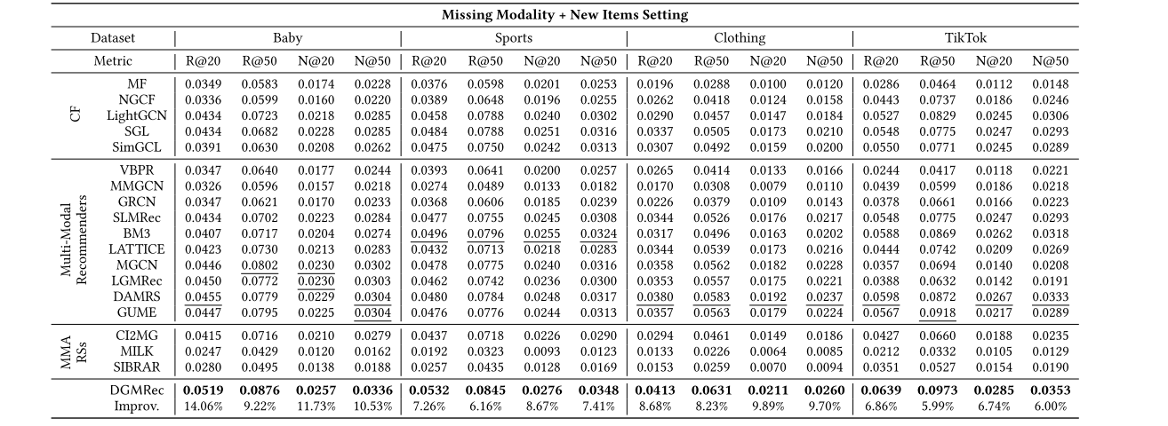
ATAI
Advanced Technique of Artificial Intelligence
ATAI
ChongqingUniversity _{AdvancedTechniqueof}
of Technology Artificial Intelligence
Chongqing University of
Technology
Chongqing University ^{ATAI}
_{of Technology} Advanced Techniqueof
Artificial Intelligence
Chongqing University of Technology
Chongqing University of Technology
Experiments

Slide 12
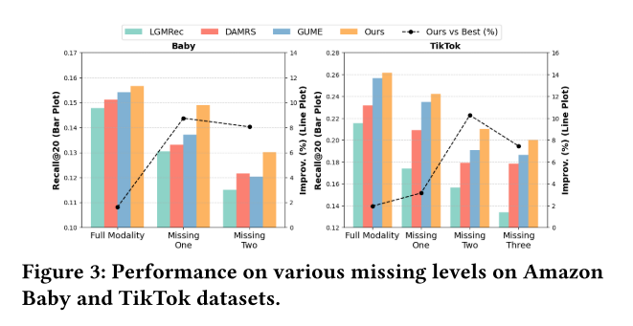
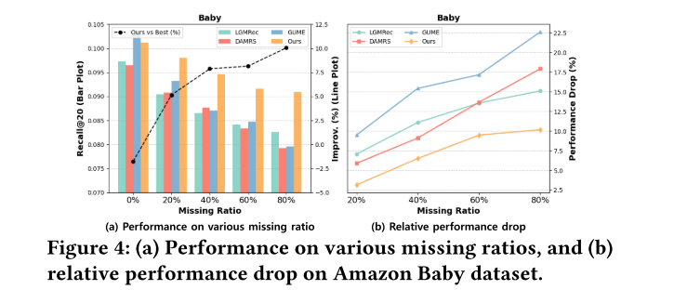
ATAI
Advanced Technique of Artificial Intelligence
ATAI
ChongqingUniversity _{AdvancedTechniqueof}
of Technology Artificial Intelligence
Chongqing University of
Technology
Chongqing University ^{ATAI}
_{of Technology} Advanced Techniqueof
Artificial Intelligence
Chongqing University of Technology
Chongqing University of Technology
Experiments

Slide 13
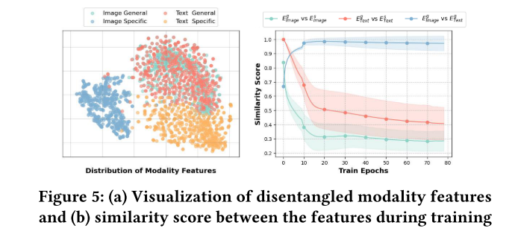
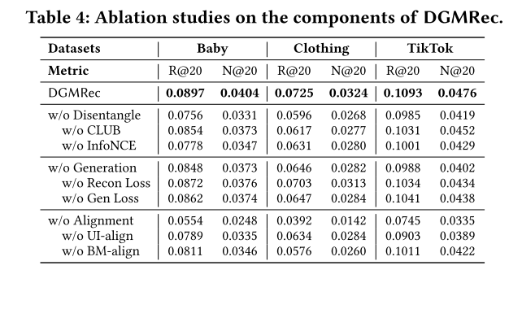
ATAI
Advanced Technique of Artificial Intelligence
ATAI
ChongqingUniversity _{AdvancedTechniqueof}
of Technology Artificial Intelligence
Chongqing University of
Technology
Chongqing University ^{ATAI}
_{of Technology} Advanced Techniqueof
Artificial Intelligence
Chongqing University of Technology
Chongqing University of Technology
Experiments

Slide 14
ATAI
Advanced Technique of Artificial Intelligence
ATAI
ChongqingUniversity _{AdvancedTechniqueof}
of Technology Artificial Intelligence
Chongqing University of
Technology
Chongqing University ^{ATAI}
_{of Technology} Advanced Techniqueof
Artificial Intelligence
Chongqing University of Technology
Chongqing University of Technology
Experiments

Slide 15
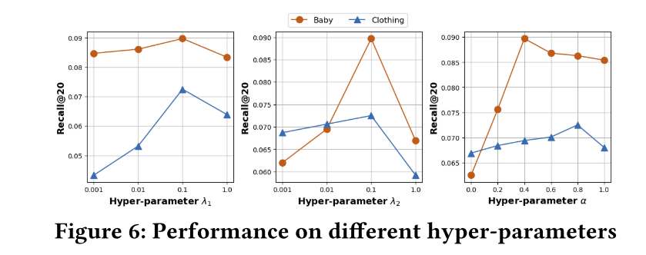
ATAI
Advanced Technique of Artificial Intelligence
ATAI
ChongqingUniversity _{AdvancedTechniqueof}
of Technology Artificial Intelligence
Chongqing University of
Technology
Chongqing University ^{ATAI}
_{of Technology} Advanced Techniqueof
Artificial Intelligence
Chongqing University of Technology
Chongqing University of Technology
Experiments

Slide 16
ATAI
Advanced Technique of Artificial Intelligence
ATAI
ChongqingUniversity _{AdvancedTechniqueof}
of Technology Artificial Intelligence
Chongqing University of
Technology
Chongqing University ^{ATAI}
_{of Technology} Advanced Techniqueof
Artificial Intelligence
Chongqing University of Technology
Chongqing University of Technology
Thanks!

